Slide 1

Virtual Reality -Team Project- by Jeremy Kirkpatrick & Zach Kahler

Slide 2
Agenda
Goals of the Project
Our Approach
Demonstration of Code Solution
Debugging the Solution

Slide 3

Goals of the Project

Slide 4
Project Goals
Create a website with an aframe page to satisfy all project parameters
Make it unique and eye catching
Keep each other accountable and on task with communication
We shared many emails and were in constant text communication
To Learn Team Working Skills
Team working skills will be paramount in our future career goals

Slide 5

Our Approach
- Divide and Conquer -

Slide 6
Divide and Conquer
Jeremy Tasks
Styles Sheet Creation
Index & Event Page Creation
Feedback on Zach’s Tasks
Shared Tasks
Overall Project Idea
Keeping Each Other Accountable
Presentation
Updates To html Files
Zach Tasks
Aframe.io
PowerPoint Creation
Feedback on Jeremy’s Tasks

Slide 7

Code Solution Demonstration

Slide 8
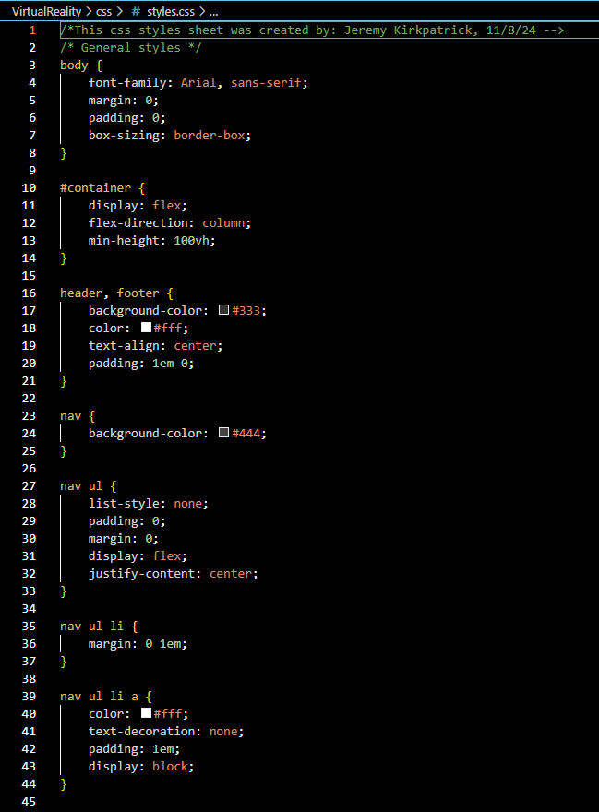
styles.css
The style sheet we used

Slide 9
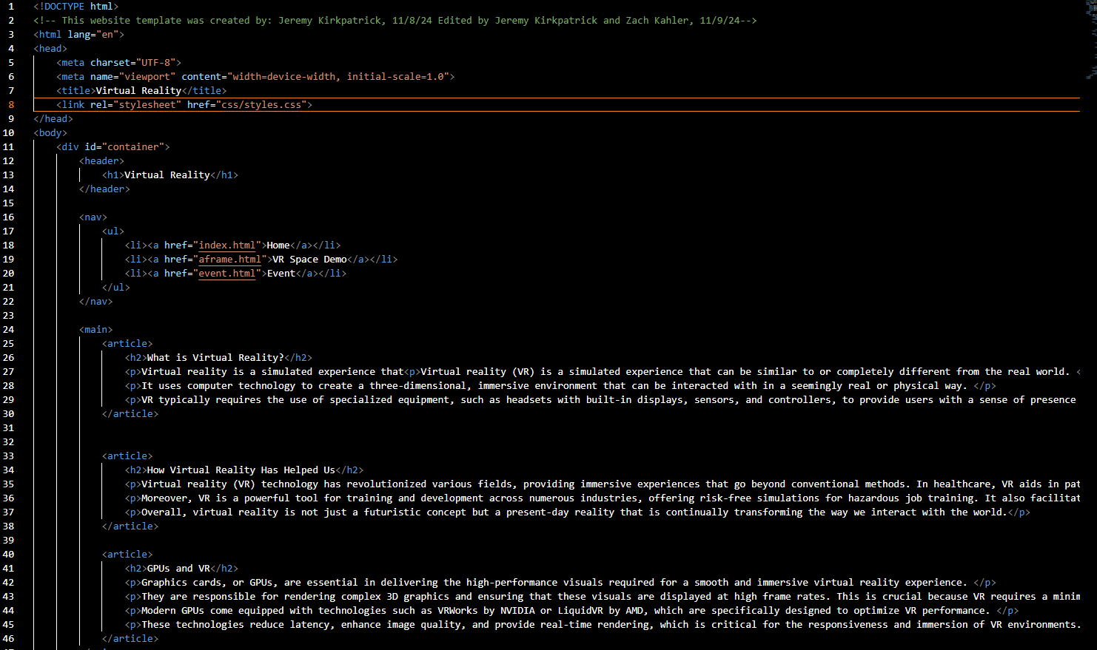
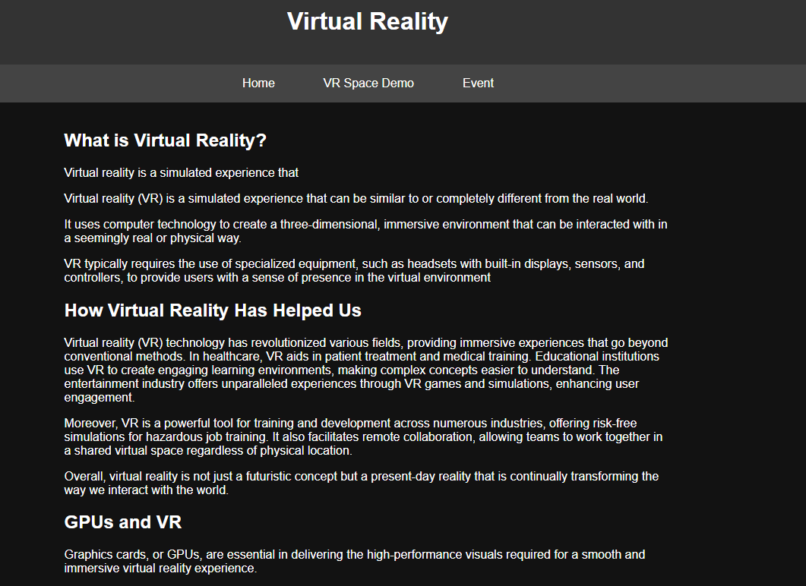
index.html
Code vs Live

Slide 10
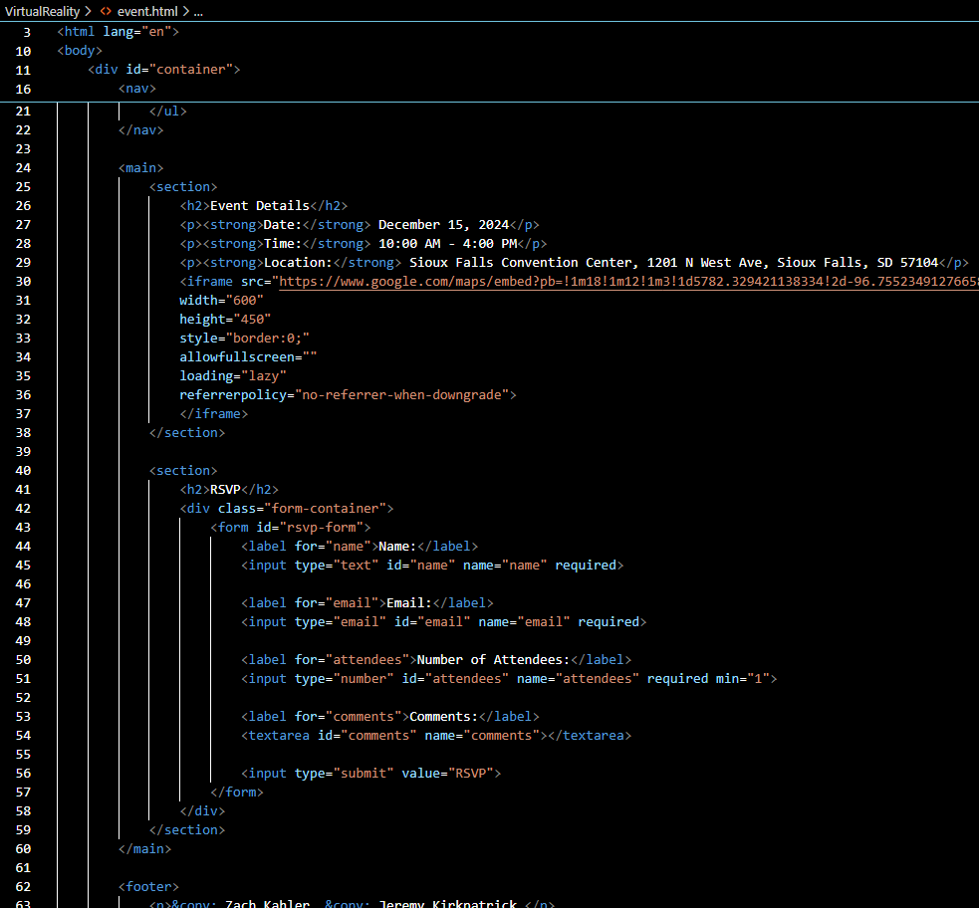
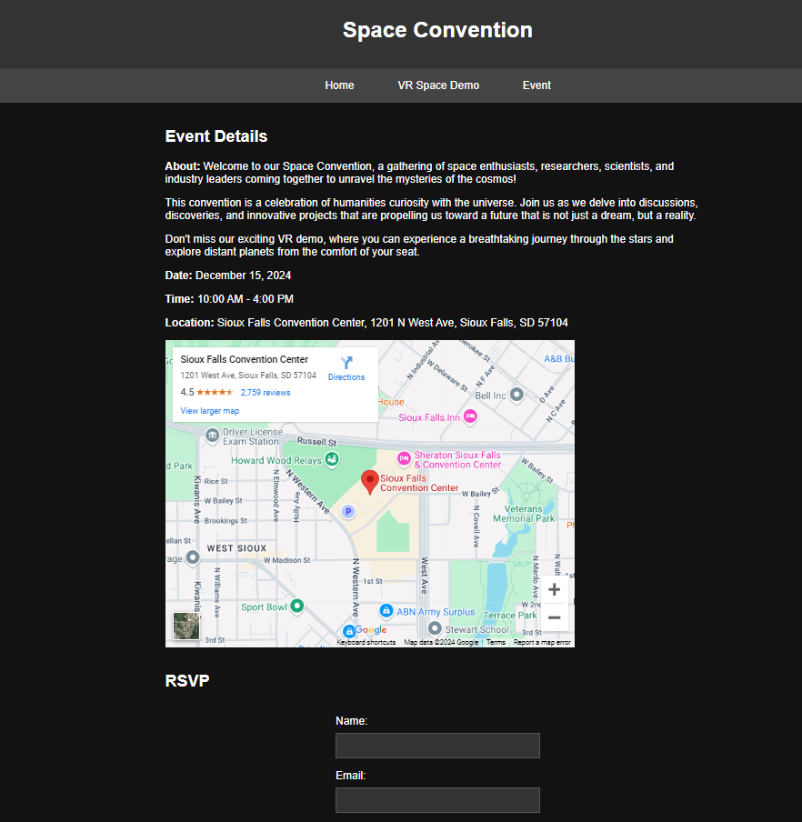
event.html
Code vs Live

Slide 11
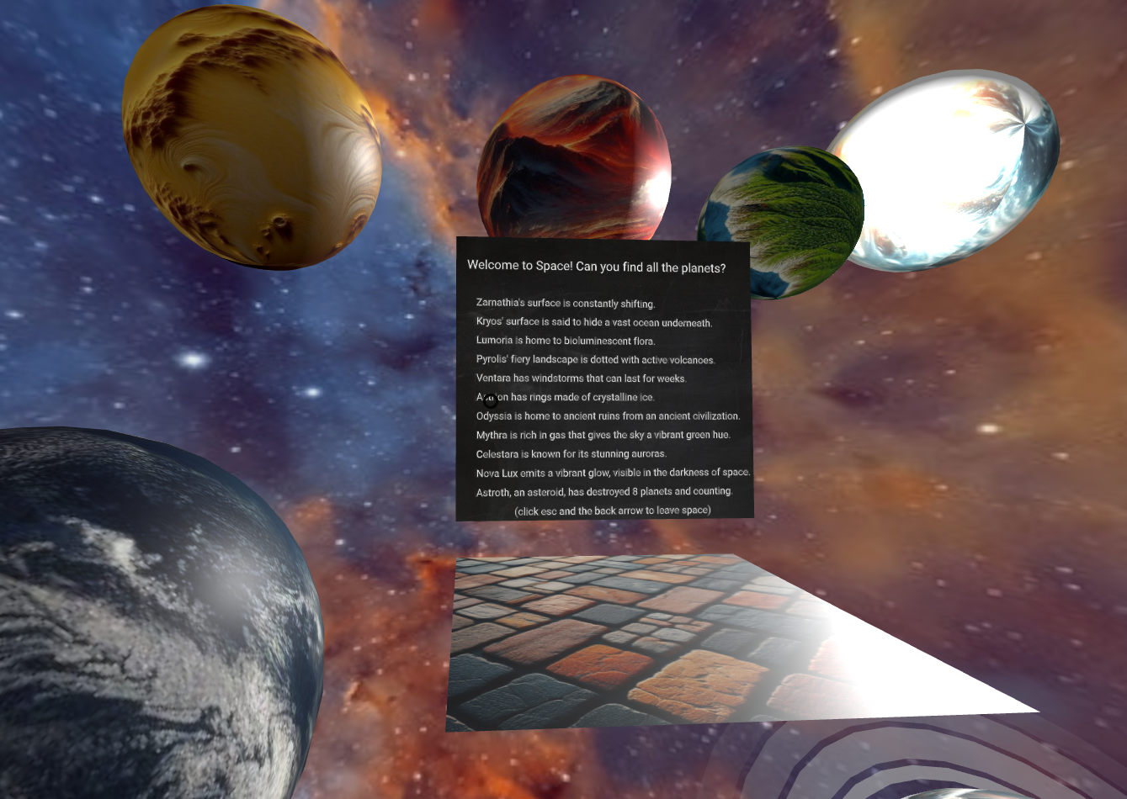
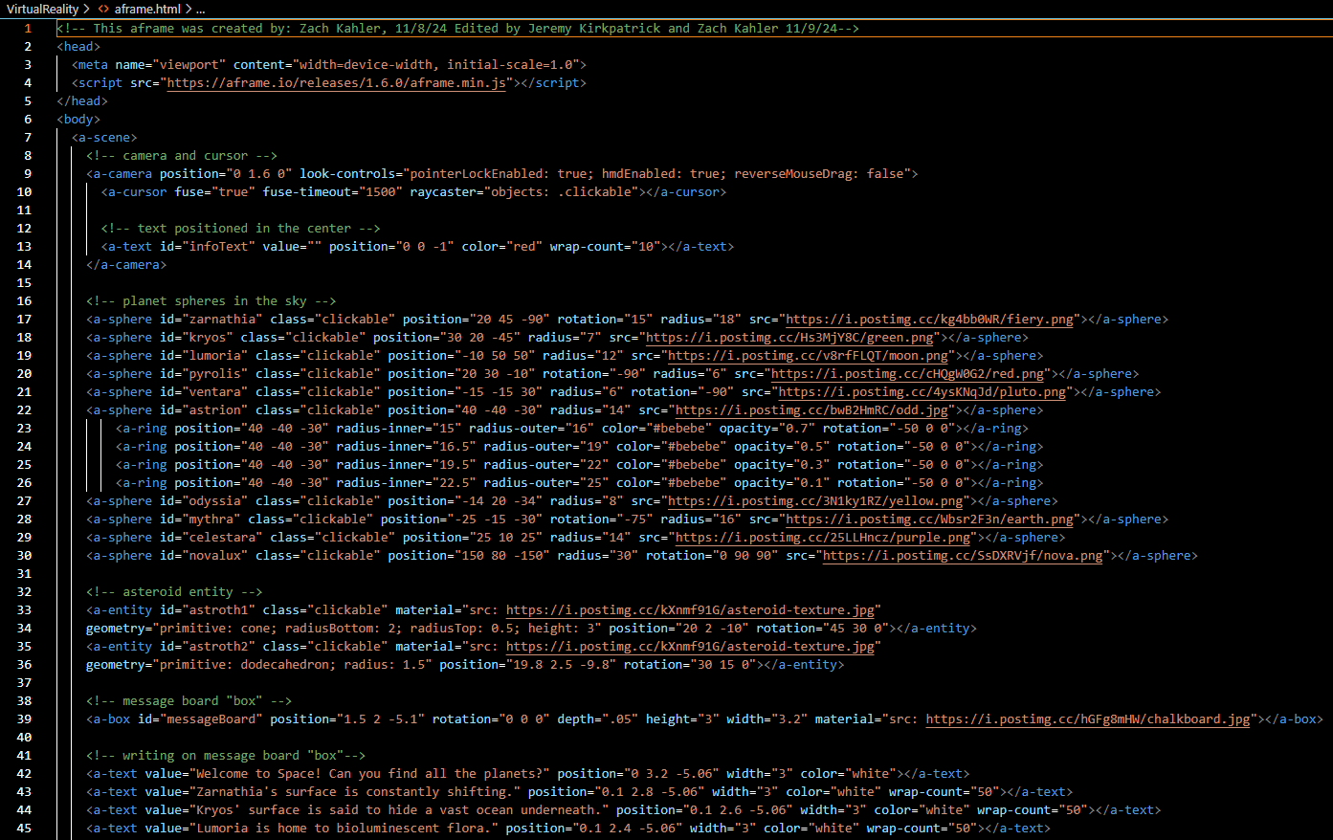
aframe.html
Code vs Live

Slide 12
Debugging

Slide 13
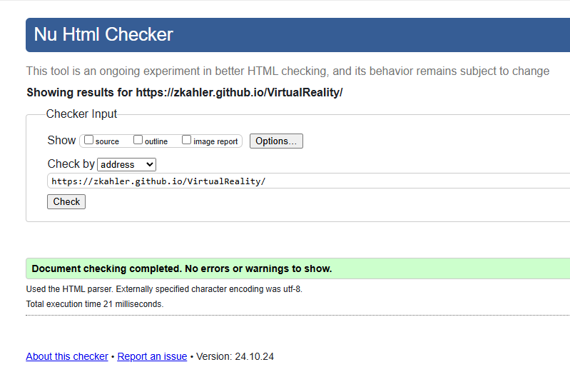
Debugging with W3 Markup Validation Service
Uploaded our website to github
Checked desktop and phone capabilities
We used the Validation service to check our website for errors

Slide 14

Thank you!
Jeremy Kirkpatrick
Zach Kahler
CIS 195 Team Project
11 / 9 / 24

